Slide 1
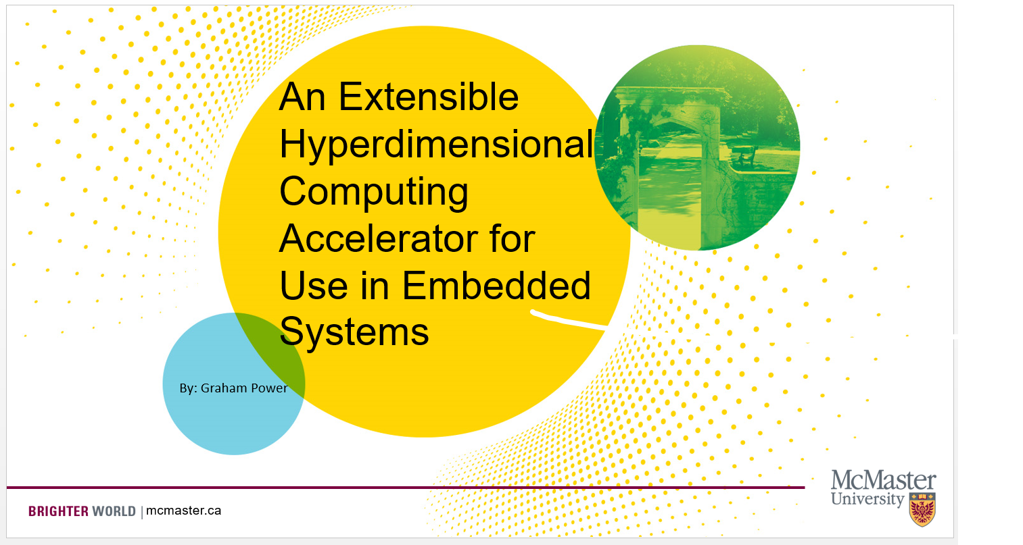

Slide 2


What Is Hyperdimensional Computing?
A Type of Computation Using Operations on Very Large Vectors
1k to 10k+ elements
Notes:
Also known as Vector Symbolic Architecture
1k to 10k+ elements

Slide 3
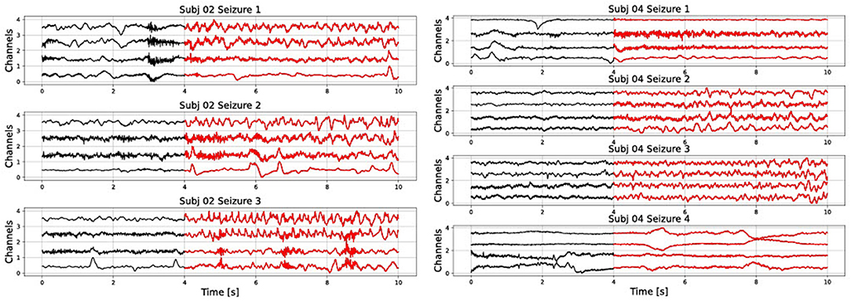
What Is Hyperdimensional Computing?
A Type of Computation Using Operations on Very Large Vectors
1k to 10k+ elements
Has Many Real-World Applications
Medical Diagnosis
https://www.frontiersin.org/articles/10.3389/fneur.2022.816294/full

Slide 4
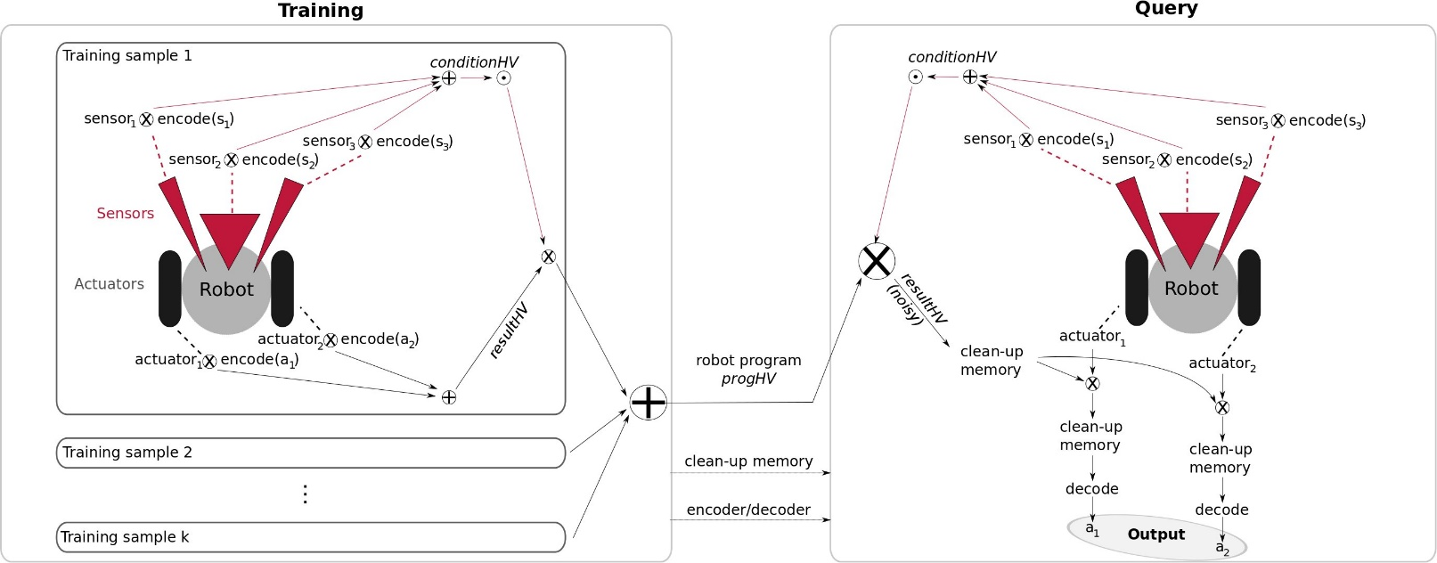
What Is Hyperdimensional Computing?
A Type of Computation Using Operations on Very Large Vectors
1k to 10k+ elements
Has Many Real-World Applications
Medical Diagnosis
Robot Localization
https://www.tu-chemnitz.de/etit/proaut/en/research/vsa.html

Slide 5
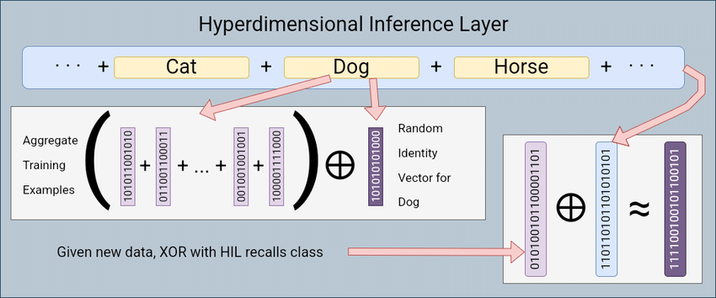
What Is Hyperdimensional Computing?
A Type of Computation Using Operations on Very Large Vectors
1k to 10k+ elements
Has Many Real-World Applications
Medical Diagnosis
Robot Localization
Text Classification
Etc.
https://www.researchgate.net/figure/Visualization-of-how-the-Hyperdimensional-Inference-Layer-HIL-2-3-learns-to_fig1_360994078

Slide 6

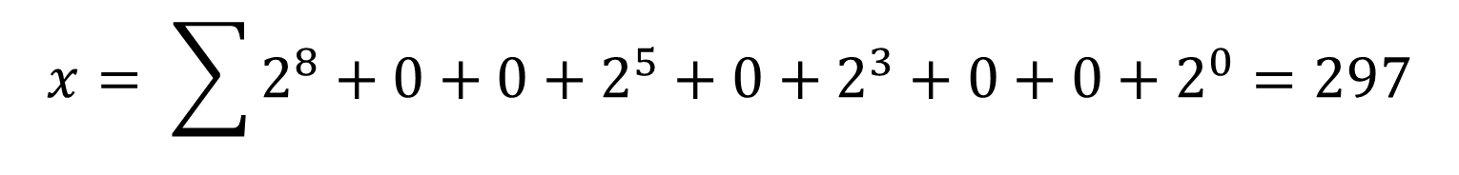
Why Use HCD?
Suppose we have some number represented in binary
What happens if there is a single bit error?
$$1 0 0 1 0 1 0 0 1$$
$$x= \sum{2^{8}+0+0+2^{5}+0+2^{3}+0+0+2^{0}}=297$$

Slide 7
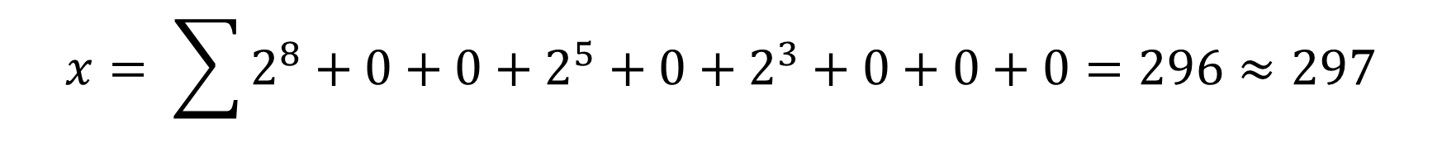

Why Use HCD?
Suppose we have some number represented in binary
What happens if there is a single bit error?
$$1 0 0 1 0 1 0 0 0$$
$$x= \sum{2^{8}+0+0+2^{5}+0+2^{3}+0+0+0}=296≈297$$
Notes:
If its in the LSB’s then there is not much of an issue

Slide 8
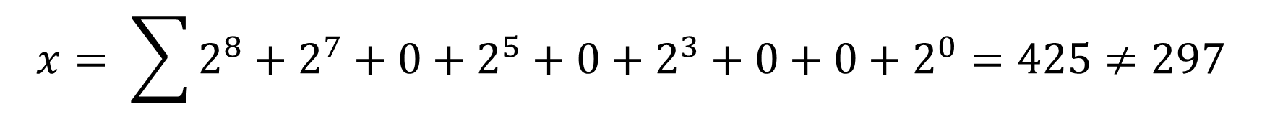

Why Use HCD?
Suppose we have some number represented in binary
What happens if there is a single bit error?
$$1 1 0 1 0 1 0 0 1$$
$$x= \sum{2^{8}+2^{7}+0+2^{5}+0+2^{3}+0+0+2^{0}}=425≠297$$
Notes:
If it in the MSB’s the entire result can be incorrect
This is because each bit in the number has a specific meaning

Slide 9


Why Use HDC?
HDC Overcomes this with distributed representations
An Example with the BSC Encoding
$$1 0 0 1 0 1 0 0 1$$
True HV
$$1 1 0 1 0 1 0 0 1$$
Errored HV
Similarity Metric = 0.889
Notes:
HDC overcomes this with distributed representations
Each number has no specific meaning on its own, but combined with the full vector the meaning can be decerned

Slide 10

Why Use HDC?
HDC Overcomes this with distributed representations
An Example with the BSC Encoding
$$1 0 0 1 0 1 0 0 1$$
True HV
$$1 0 0 1 1 1 0 0 1$$
Errored HV
Similarity Metric = 0.889
Notes:
HDC overcomes this with distributed representations
Each number has no specific meaning on its own, but combined with the full vector the meaning can be decerned

Slide 11

Why Use HDC?
HDC Overcomes this with distributed representations
An Example with the BSC Encoding
$$1 0 0 1 0 1 0 0 1$$
True HV
$$1 0 0 0 0 1 0 0 1$$
Errored HV
Similarity Metric = 0.889
Notes:
HDC overcomes this with distributed representations
Each number has no specific meaning on its own, but combined with the full vector the meaning can be decerned

Slide 12

Why Use HDC?
HDC Overcomes this with distributed representations
An Example with the BSC Encoding
$$1 0 0 1 0 1 0 0 1$$
True HV
$$1 0 0 1 0 1 0 1 1$$
Errored HV
Similarity Metric = 0.889
Notes:
HDC overcomes this with distributed representations
Each number has no specific meaning on its own, but combined with the full vector the meaning can be decerned

Slide 13
What Operations Does HDC Require?
There Are 3 Main Operations In HDC
Similarity
Bundling
Binding

Slide 14
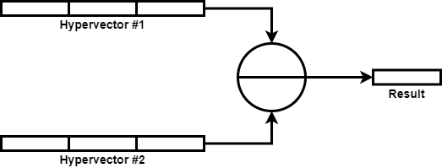
What Operations Does HDC Require?
Similarity
Takes two vectors and returns a single number (ideally between -1 and 1) to tell you how similar the vectors are

Slide 15
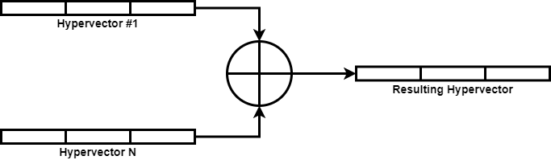
What Operations Does HDC Require?
Bundling
Takes 2+ inputs and produces an output vector highly similar to all inputs

Slide 16
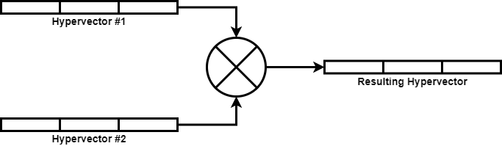
What Operations Does HDC Require?
Binding
Takes 2 inputs and produces an output vector highly dis-similar to both inputs

Slide 17
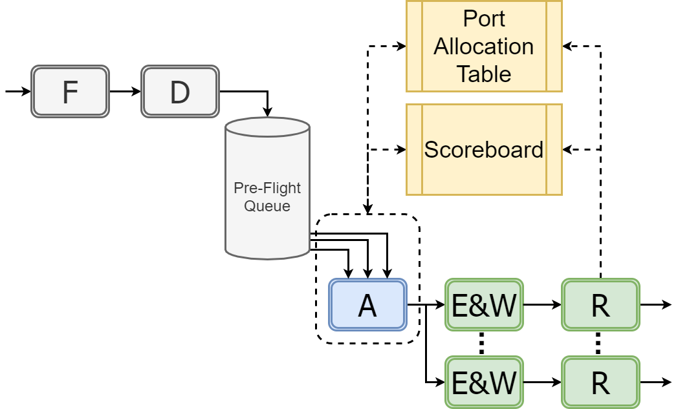
How To Accelerate HDC?
Notes:
While kernels for each type of operation have some differences, they are largely the same. We will be focusing on the bundling
Most of these HDC encodings are embarrassingly parallel
This allows us to compute bundling, binding, and similarity result elements independently

Slide 18
How To Accelerate HDC?
Notes:
While kernels for each type of operation have some differences, they are largely the same. We will be focusing on the bundling
Most of these HDC encodings are embarrassingly parallel
This allows us to compute bundling, binding, and similarity result elements independently

Slide 19
How To Accelerate HDC?
Allocate Ports
Notes:
While kernels for each type of operation have some differences, they are largely the same. We will be focusing on the bundling
Most of these HDC encodings are embarrassingly parallel
This allows us to compute bundling, binding, and similarity result elements independently

Slide 20
How To Accelerate HDC?
Allocate Ports
Notes:
While kernels for each type of operation have some differences, they are largely the same. We will be focusing on the bundling
Most of these HDC encodings are embarrassingly parallel
This allows us to compute bundling, binding, and similarity result elements independently

Slide 21
How To Accelerate HDC?
Allocate Ports
Notes:
While kernels for each type of operation have some differences, they are largely the same. We will be focusing on the bundling
Most of these HDC encodings are embarrassingly parallel
This allows us to compute bundling, binding, and similarity result elements independently

Slide 22
How To Accelerate HDC?
Release Ports
Allocate Ports
Notes:
While kernels for each type of operation have some differences, they are largely the same. We will be focusing on the bundling
Most of these HDC encodings are embarrassingly parallel
This allows us to compute bundling, binding, and similarity result elements independently

Slide 23
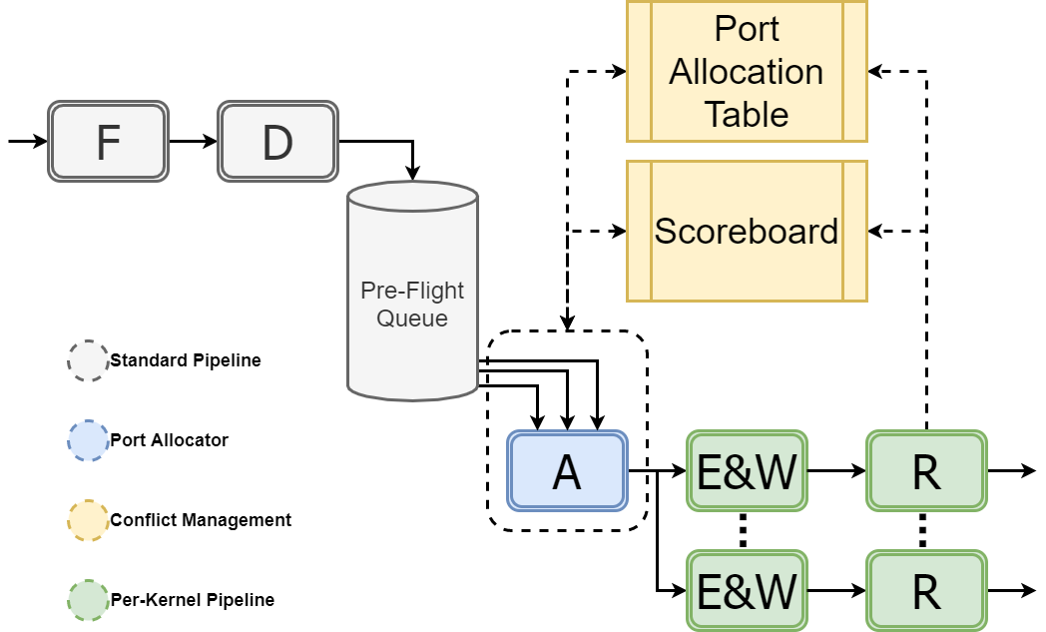
How To Accelerate HDC?
Release Ports
Allocate Ports
Notes:
While kernels for each type of operation have some differences, they are largely the same. We will be focusing on the bundling
Most of these HDC encodings are embarrassingly parallel
This allows us to compute bundling, binding, and similarity result elements independently

Slide 24
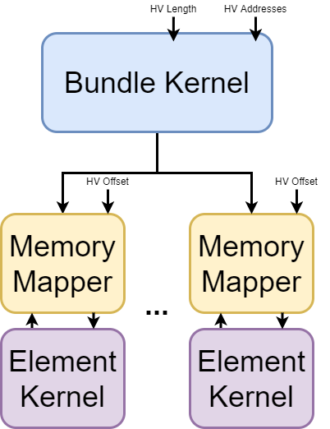
Bundle Kernel Hierarchy

Slide 25
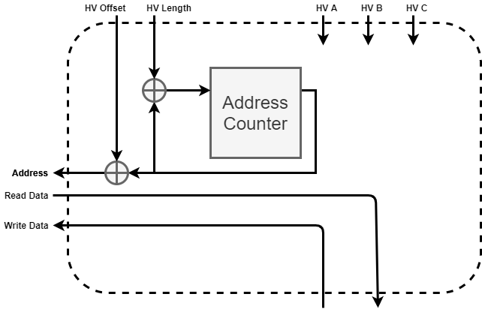
Memory Mapper

Slide 26
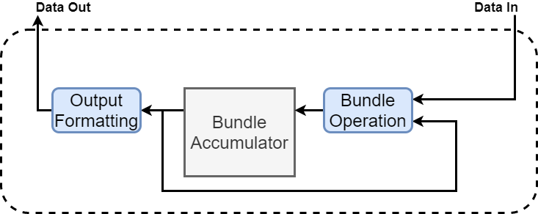
Element Kernel

Slide 27
Our Full Architecture Reviewed
Release Ports
Allocate Ports
Notes:
While kernels for each type of operation have some differences, they are largely the same. We will be focusing on the bundling
Most of these HDC encodings are embarrassingly parallel
This allows us to compute bundling, binding, and similarity result elements independently

Slide 28
Questions?

Slide 29
Bonus Slides
State-Flow Diagrams
Bundle Kernel
Element Kernel
Memory Mapper
Transaction Waveforms
Bundle Kernel
Element Kernel
Memory Mapper
Estimated Resource Usage

Slide 30
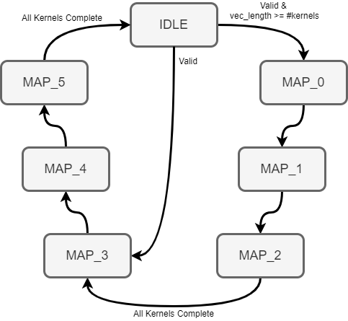
Bundle Kernels State-Flow

Slide 31
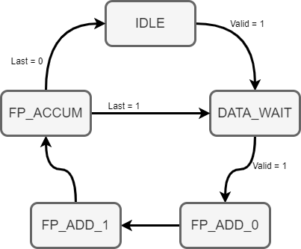
Element Kernel State-Flow

Slide 32
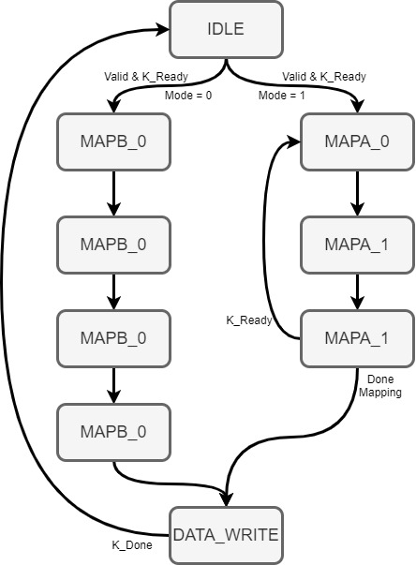
Memory Mapper State-Flow

Slide 33
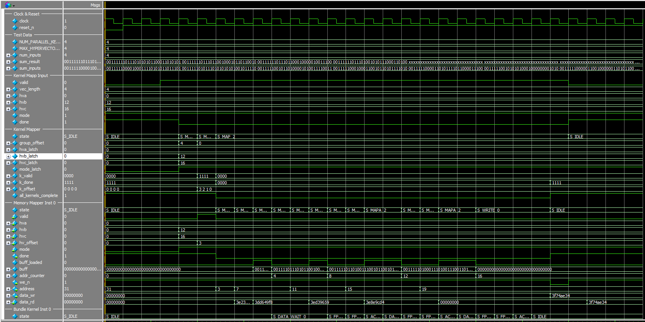
Bundle Kernel Transaction Waveforms

Slide 34
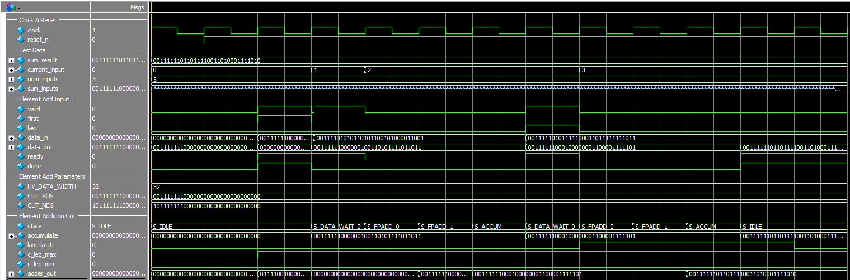
Element Kernel Transaction Waveforms

Slide 35
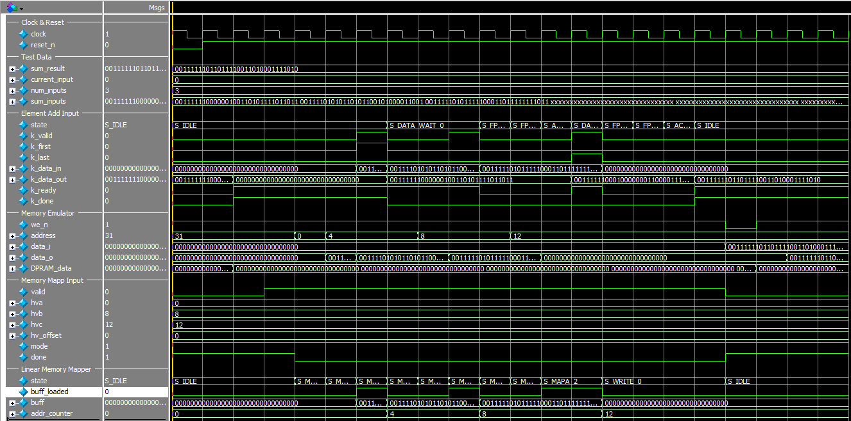
Memory Mapper Transaction Waveforms

Slide 36
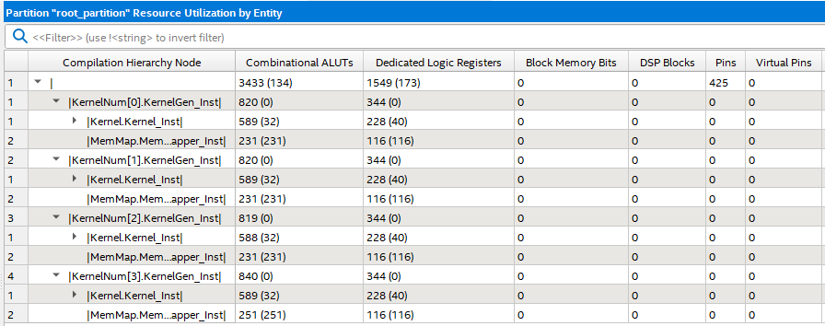
Estimated Resource Usage
Bundle Kernel Mapper
Bundle Kernel Generator
Bundle Kernel
Bundle Memory Mapper

